Slide 1


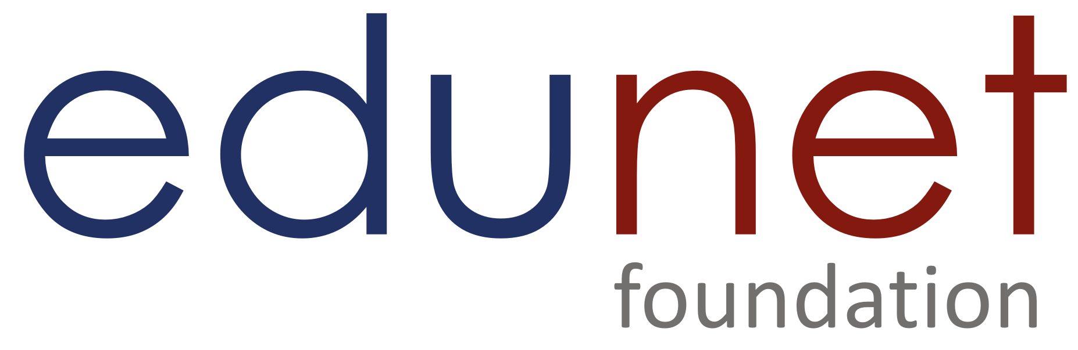

NEXT GEN EMPLOYABILITY PROGRAM
Creating a future-ready workforce
Team Members
College Name
Student Name : Deepak K
Student ID :au711021205005
Info Institute of engineering

Slide 2
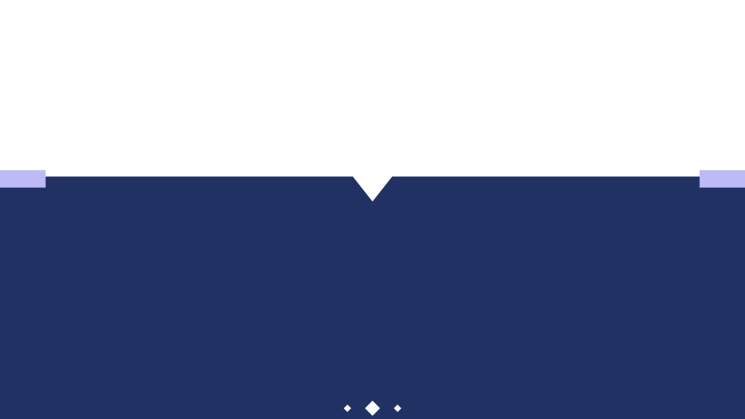
CAPSTONE PROJECT SHOWCASE
Project Title
Notes Sharing Web Application using Django Framework
Abstract | Problem Statement | Project Overview | Proposed Solution | Technology Used | Modelling & Results | Conclusion

Slide 3
Abstract
This project aims to develop a notes sharing web application using the Django framework. The application allows users to create, read, update, and delete notes, while also enabling them to share notes with other users. The system includes user authentication and permission handling to ensure secure access to notes. The application's architecture follows the Model-View-Controller (MVC) pattern, with models defining the data structure, views handling user requests, and templates rendering the interface. Additionally, the application incorporates CSS styling for an enhanced user experience. Deployment options include platforms such as Heroku, AWS, or DigitalOcean. This project serves as a practical demonstration of building a collaborative web application using Django, facilitating efficient note management and sharing among users. The Django framework will be utilized for its robustness, scalability, and built-in security features. Through this application, users will be able to collaborate effectively on projects, share knowledge, and streamline their note-taking process in a collaborative and efficient manner.
Source :https://github.com/Deepak772004

Slide 4
Problem Statement
The objective of this project is to design and implement a comprehensive Notes Sharing Web Application using the Django framework. The existing landscape lacks a user-friendly platform for efficient note creation, management, and collaboration. This application aims to fill this gap by providing users with a seamless interface to create, edit, and share notes securely. Key features include user authentication, permission management, and robust data security measures. By addressing these challenges, the proposed solution seeks to enhance productivity and facilitate seamless collaboration among users, ultimately providing a tailored solution for effective note-sharing needs. Traditional methods of note-taking, such as physical notebooks or standalone digital documents, lack collaborative features and struggle to keep pace with the dynamic nature of modern workflows. As a result, there is a growing need for a web-based note-sharing solution that offers secure, organized, and collaborative note-taking capabilities.
Source :https://github.com/Deepak772004

Slide 5
Project Overview
The note-sharing web application, developed using the Django framework, offers users a robust platform for creating, organizing, and collaborating on notes. Through secure user authentication and management functionalities, individuals can seamlessly log in, create, and edit their notes while ensuring data privacy. The application fosters collaboration by enabling users to share notes with others, assigning varying levels of access permissions to facilitate teamwork. With a focus on user experience, the platform incorporates advanced search and filtering capabilities, allowing users to quickly locate specific notes. Emphasizing security, the application implements encryption measures and adheres to best practices to safeguard user data. Its responsive design ensures accessibility across different devices, while scalability and performance optimizations guarantee smooth operation even under high traffic conditions. Comprehensive documentation and rigorous testing further enhance usability and reliability, positioning the note-sharing web application as a modern solution for efficient knowledge sharing and collaboration.
Source :https://github.com/Deepak772004

Slide 6
Proposed Solution
.
The proposed solution is a note-sharing web application built using the Django framework, aimed at addressing the challenges of traditional note-taking methods and fostering collaboration among users. Through intuitive user interfaces and secure authentication mechanisms, the platform enables individuals to create, organize, and share notes effortlessly. Users can collaborate on projects by sharing notes with team members and assigning appropriate access levels, enhancing productivity and efficiency. Advanced search and filtering functionalities empower users to quickly locate relevant information within their note collections, facilitating seamless information retrieval. By prioritizing security measures such as encryption and adherence to best practices, the application ensures the confidentiality and integrity of user data. With a responsive design optimized for various devices and scalability enhancements, the solution promises a seamless user experience, even as user bases and note volumes grow. Through comprehensive documentation and rigorous testing, the proposed solution aims to deliver a reliable and user-friendly note-sharing platform that meets the evolving needs of modern knowledge workers and teams.
Source :https://github.com/Deepak772004

Slide 7
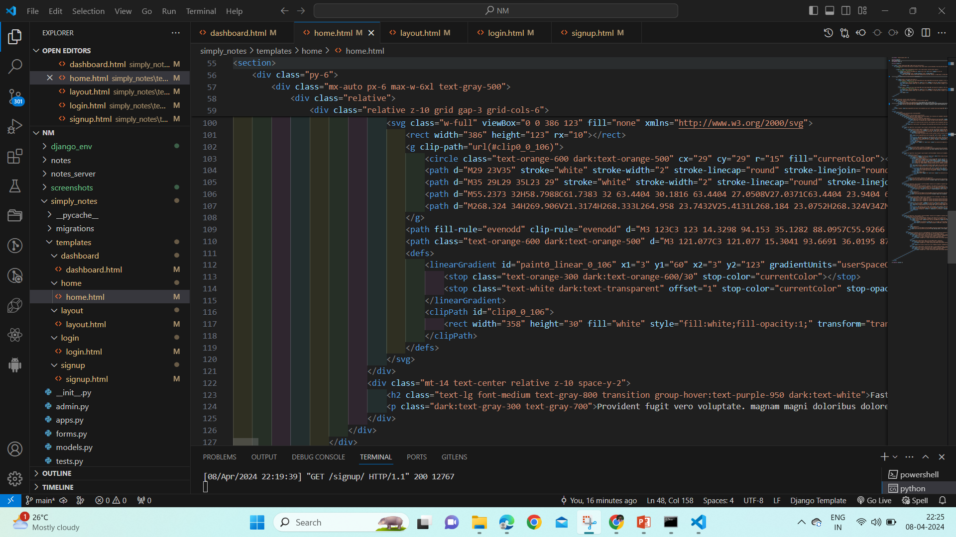
Source :https://github.com/Deepak772004

Slide 8
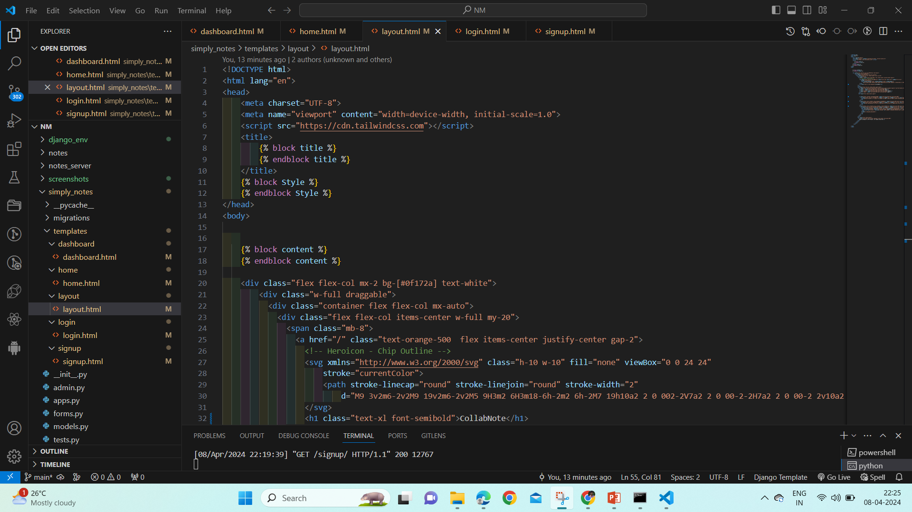
Source :https://github.com/Deepak772004

Slide 9


Technology Used
Front-end
Back-end
Source :

Slide 10
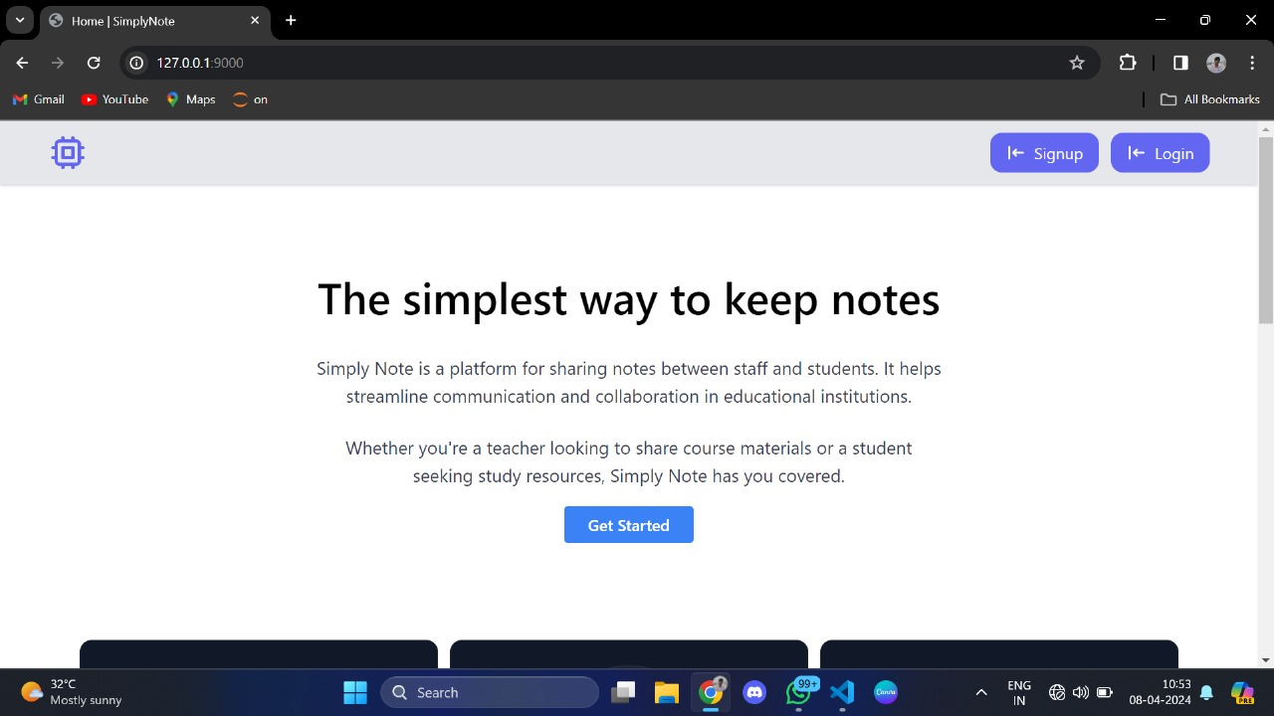
Modelling & Results
Source :

Slide 11
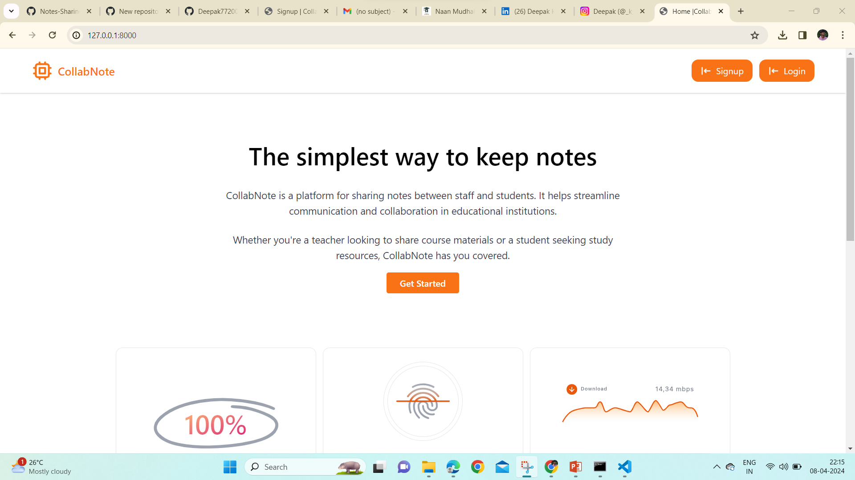
Homepage

Slide 12
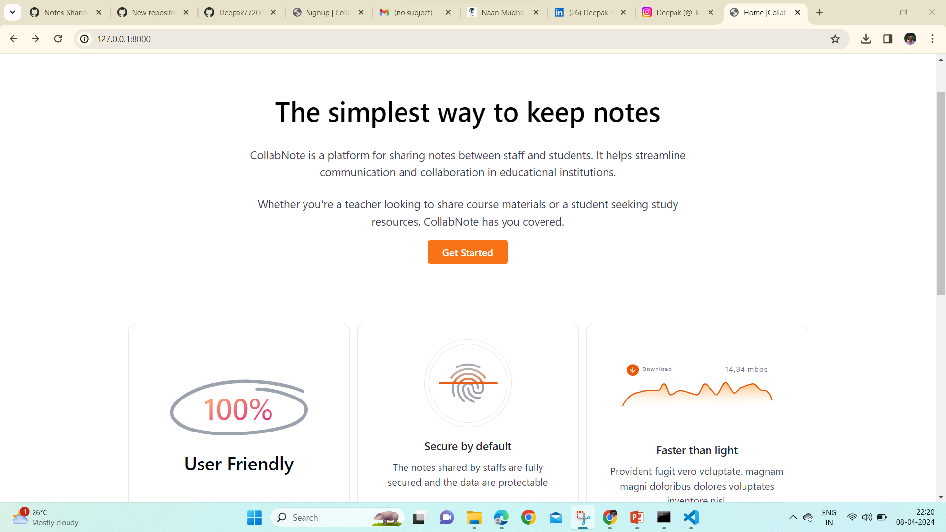
About-Us-Page

Slide 13
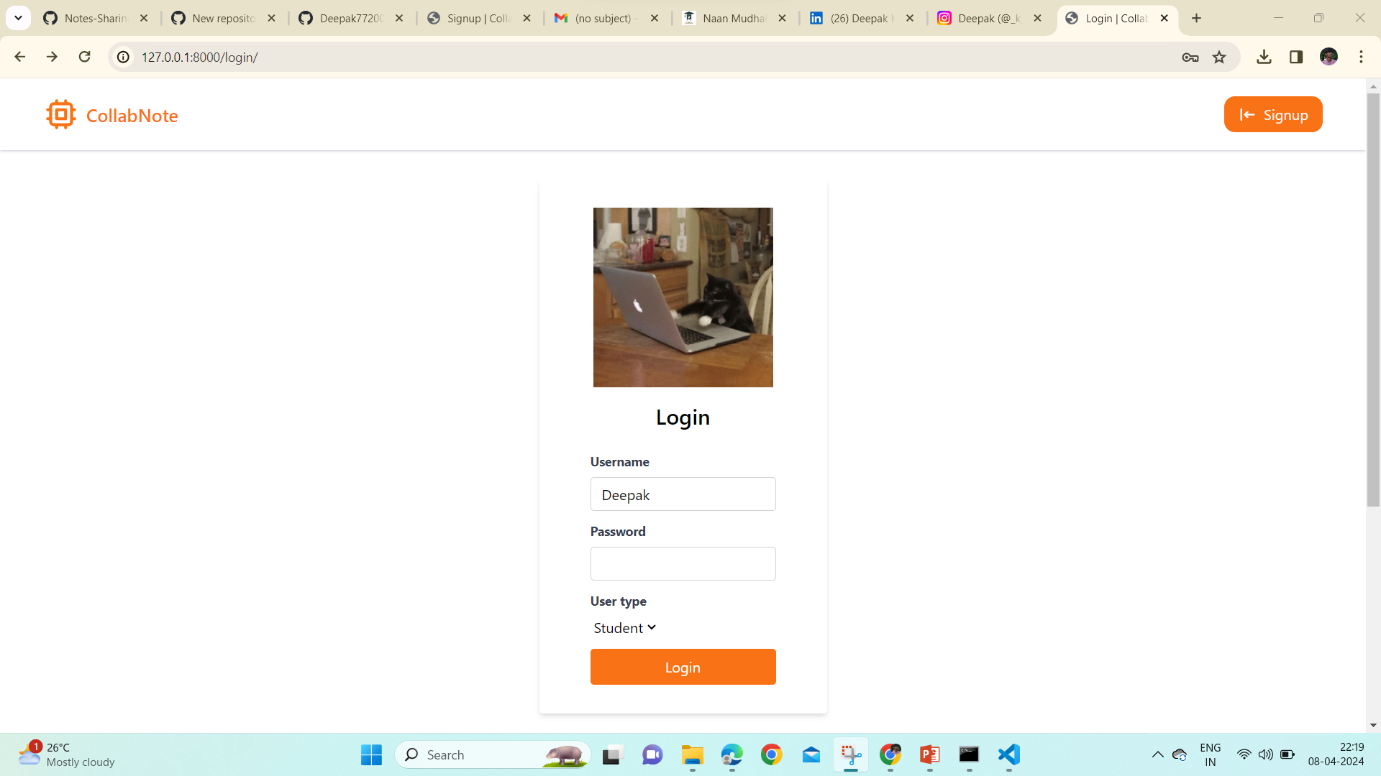
Login-Page

Slide 14
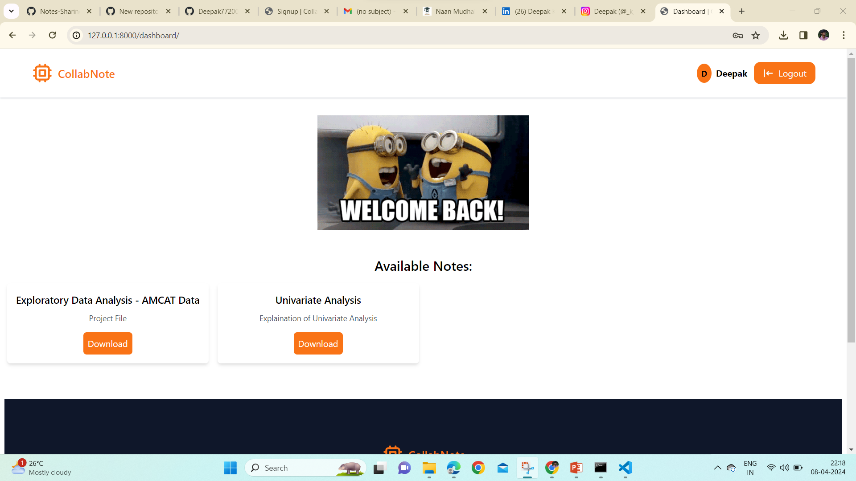
Dashboard-Page

Slide 15
Future Enhancements:
In future iterations, several enhancements could be introduced to further enrich the note-sharing web application. Integration of real-time collaboration features, such as simultaneous editing and commenting, would enhance teamwork and streamline communication among users. Additionally, the implementation of machine learning algorithms could enable intelligent note organization and recommendation functionalities, assisting users in categorizing and discovering relevant content more effectively. Enhanced support for multimedia content, including images, videos, and audio recordings, could enrich the note-taking experience and broaden the types of information that can be shared and collaborated on within the platform. Integration with popular productivity tools and platforms, such as Google Drive or Microsoft Office 365, would facilitate seamless interoperability and data exchange, further enhancing user productivity and workflow integration. Furthermore, the addition of social features, such as user profiles, activity feeds, and user-generated content sharing, could foster a sense of community and encourage user engagement within the platform. By continuously iterating and incorporating user feedback, these future enhancements aim to elevate the note-sharing web application into a comprehensive and indispensable tool for knowledge sharing and collaboration in the digital age.

Slide 16
Conclusion
In conclusion, the note-sharing web application developed using the Django framework presents a comprehensive solution to the challenges of traditional note-taking methods. By offering secure user authentication, intuitive note creation and organization, robust collaboration features, and advanced search capabilities, the application streamlines information management and fosters productive teamwork. With a focus on security, scalability, and user experience, the platform provides a reliable and user-friendly environment for individuals and teams to collaborate effectively. Through future enhancements such as real-time collaboration, machine learning-driven intelligence, multimedia support, and integration with productivity tools, the application has the potential to further enhance productivity and user engagement. Overall, the note-sharing web application represents a valuable tool for modern knowledge workers seeking efficient and collaborative note-taking solutions in today's digital landscape.
Source :

Slide 17
Thank You!
Notes:
Thank You !!

